Slide 1
D&D EDA

Slide 2
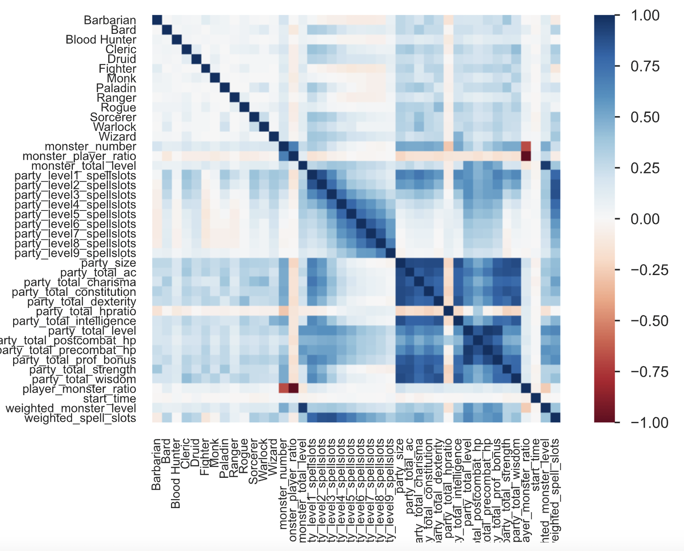
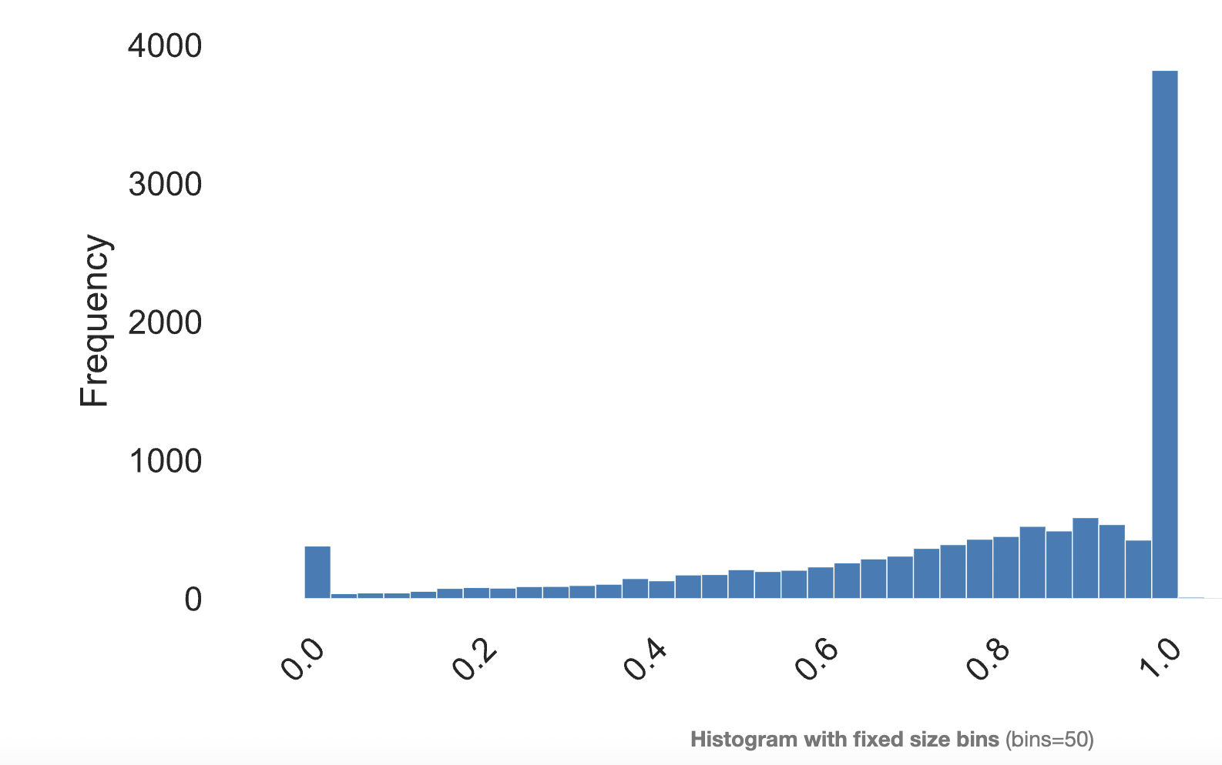
Scaled & Filtered (04-05) – All Data
11507 Observations
HP Ratio Histogram
1 = no HP lost
0 = TPK

Slide 3
Scaled & Filtered (04-05) – All Data
11507 Observations
Mostly negligible correlations between all variables and party_total_hpratio

Slide 4
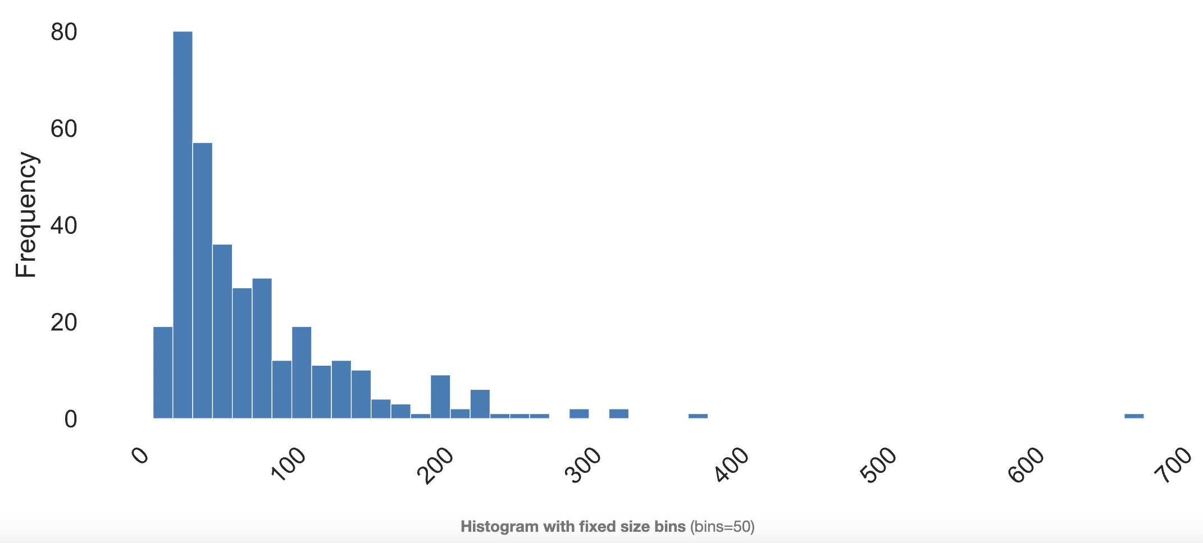
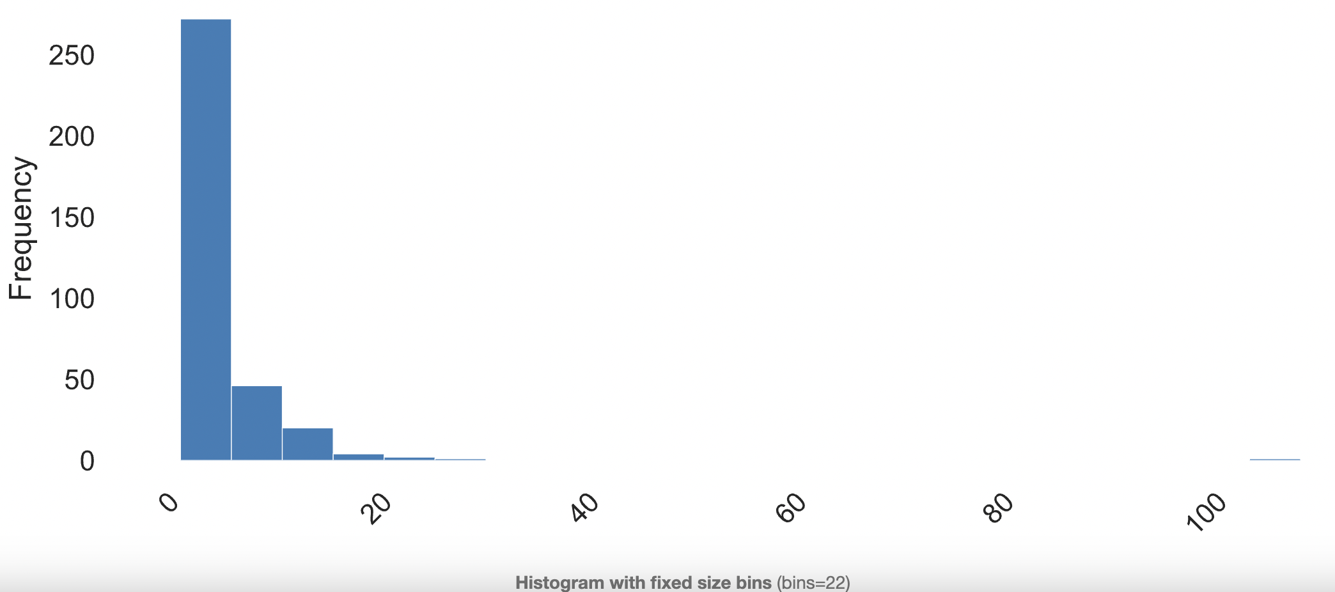
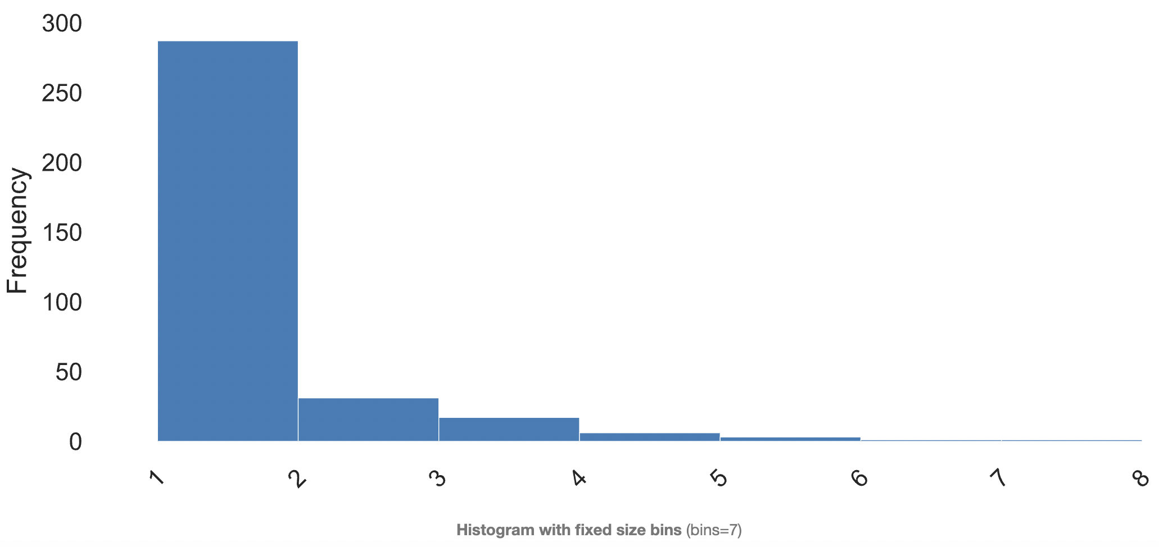
Scaled & Filtered (04-05) – Only TPK
11507 Observations Initially → 346 Observations
Precombat HP Histogram
Total Party HP Ratio of 0
All have postcombat_hp of 0
Variety of precombat hps (see histogram)]
No weird data situations that I can find… seems like legitimate TPKs
Party Size Histogram
Monster Number Histogram

Slide 5
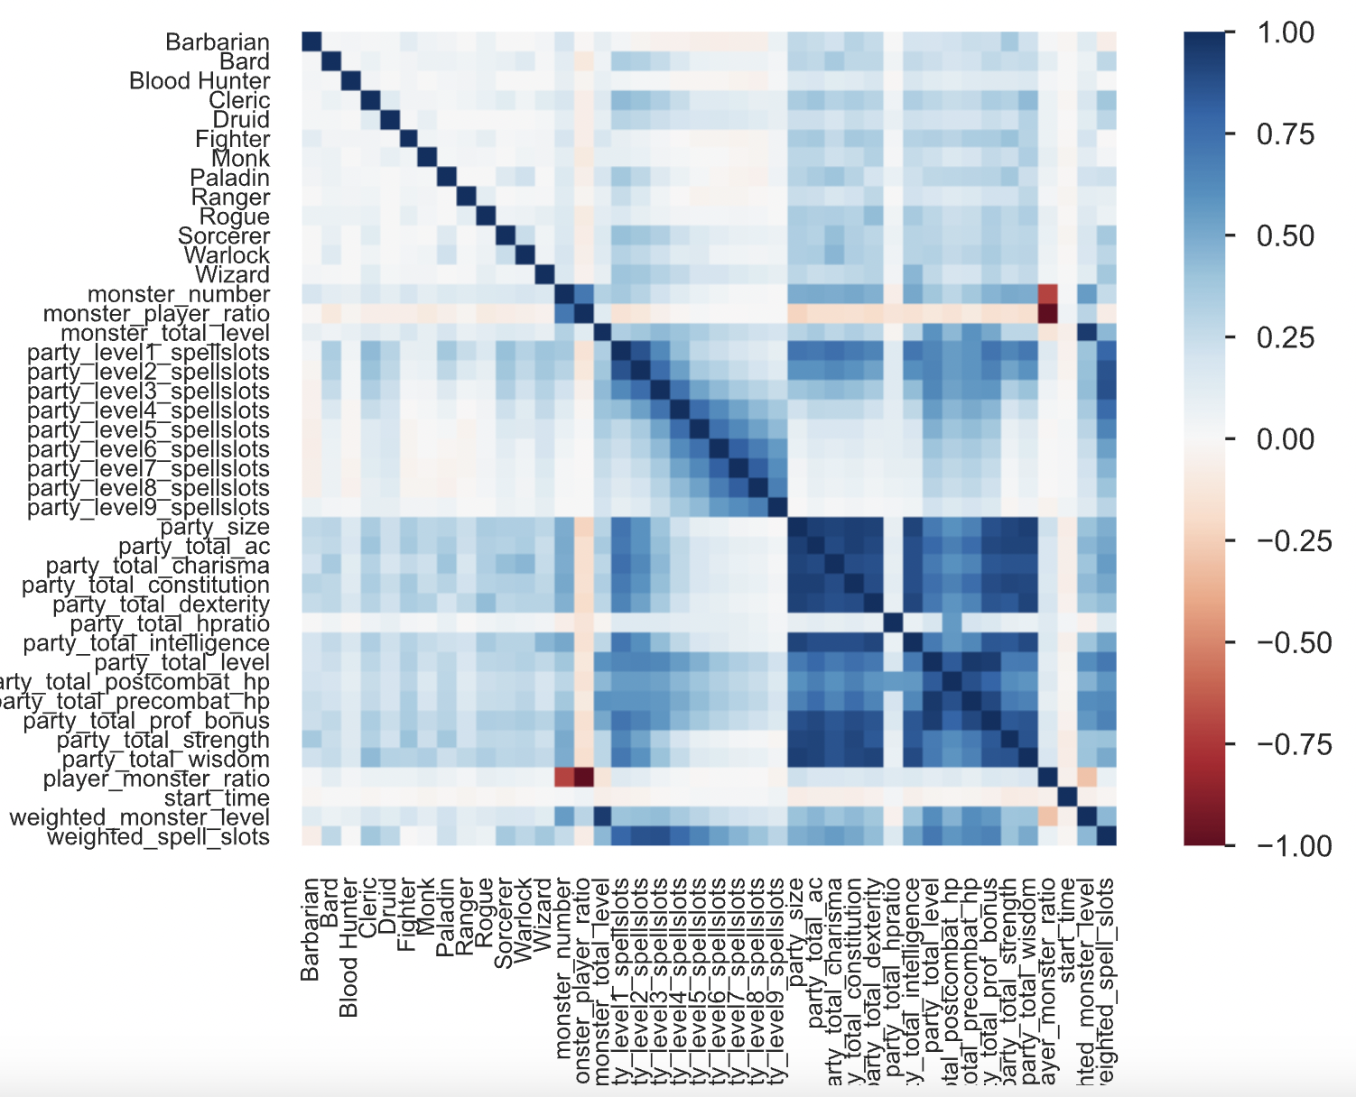
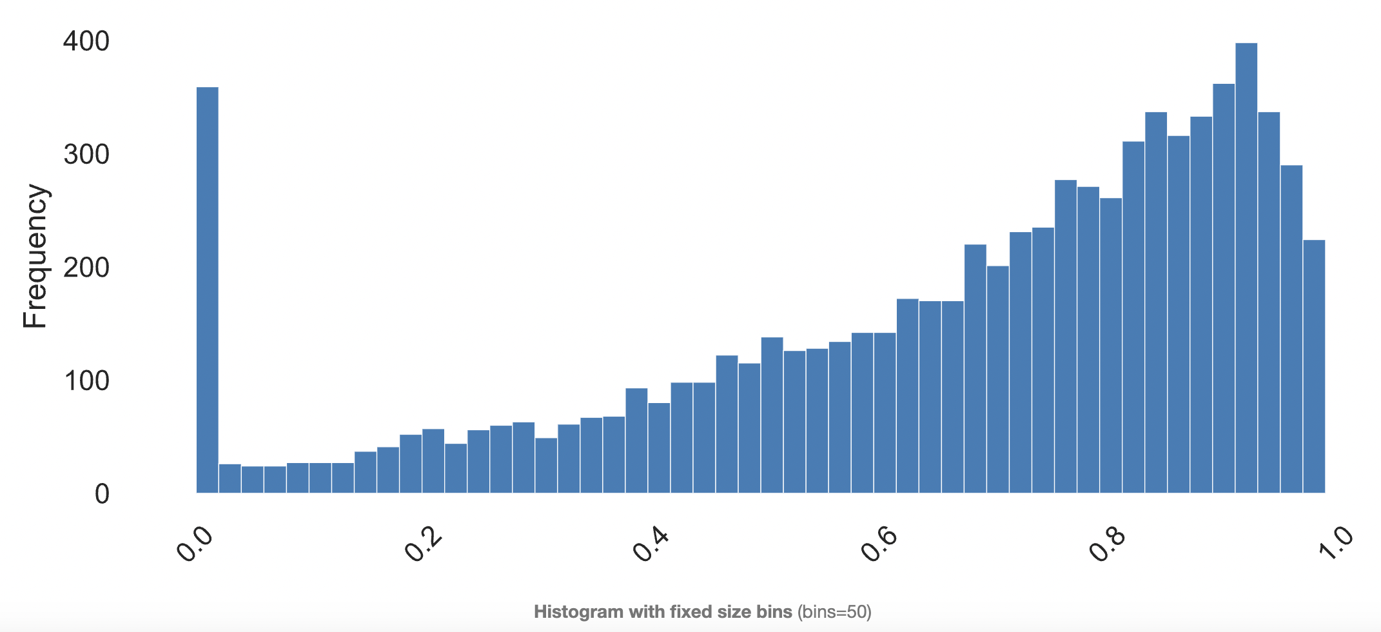
Scaled & Filtered (04-05) – HP Ratio < 1
11507 Observations Initially → 7701 Observations
HP Ratio Histogram
Removed all instances of HP Ratio >= 1
Negligible correlations

Slide 6
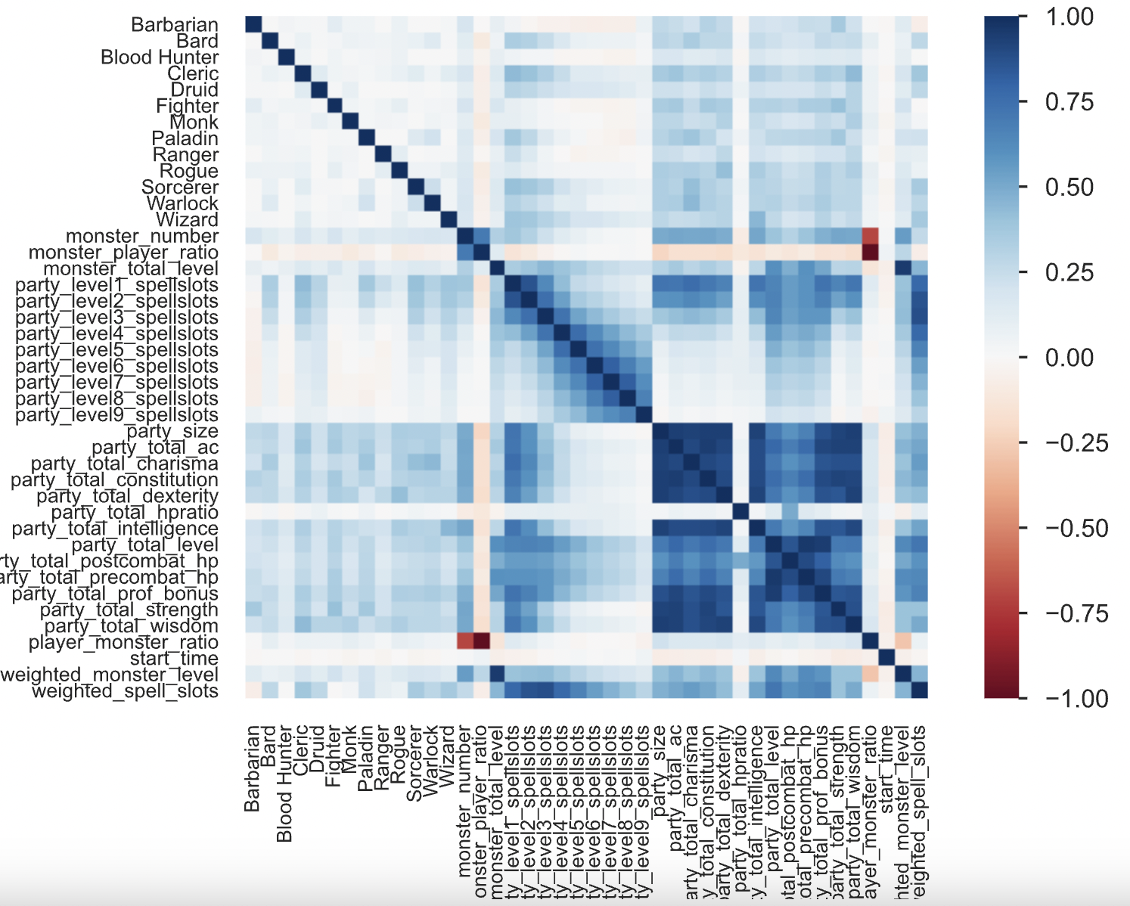
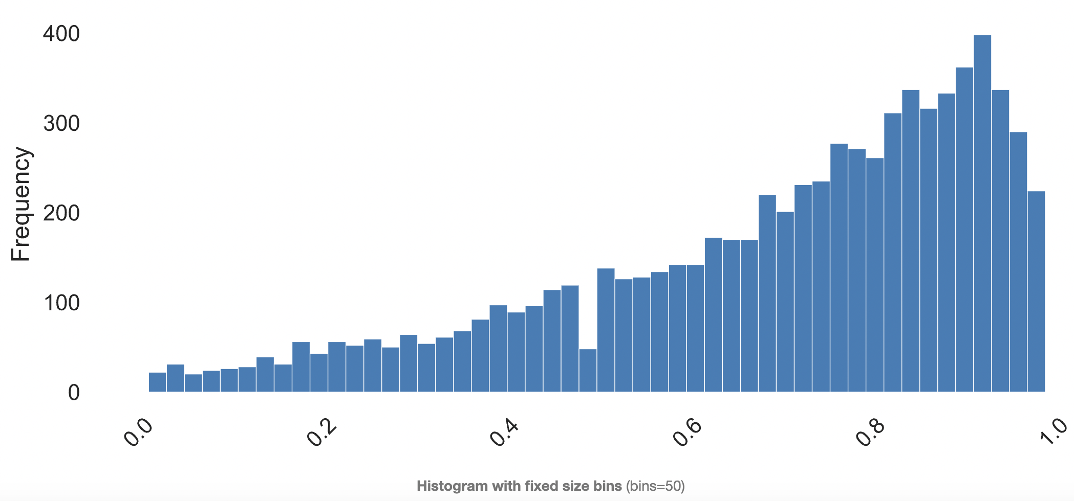
Scaled & Filtered (04-05) – No TPK & HP Ratio < 1
11507 Observations Initially → 7354 Observations
HP Ratio Histogram
Removed all instances of HP Ratio >= 1 and all TPKs
Negligible correlations

Slide 7
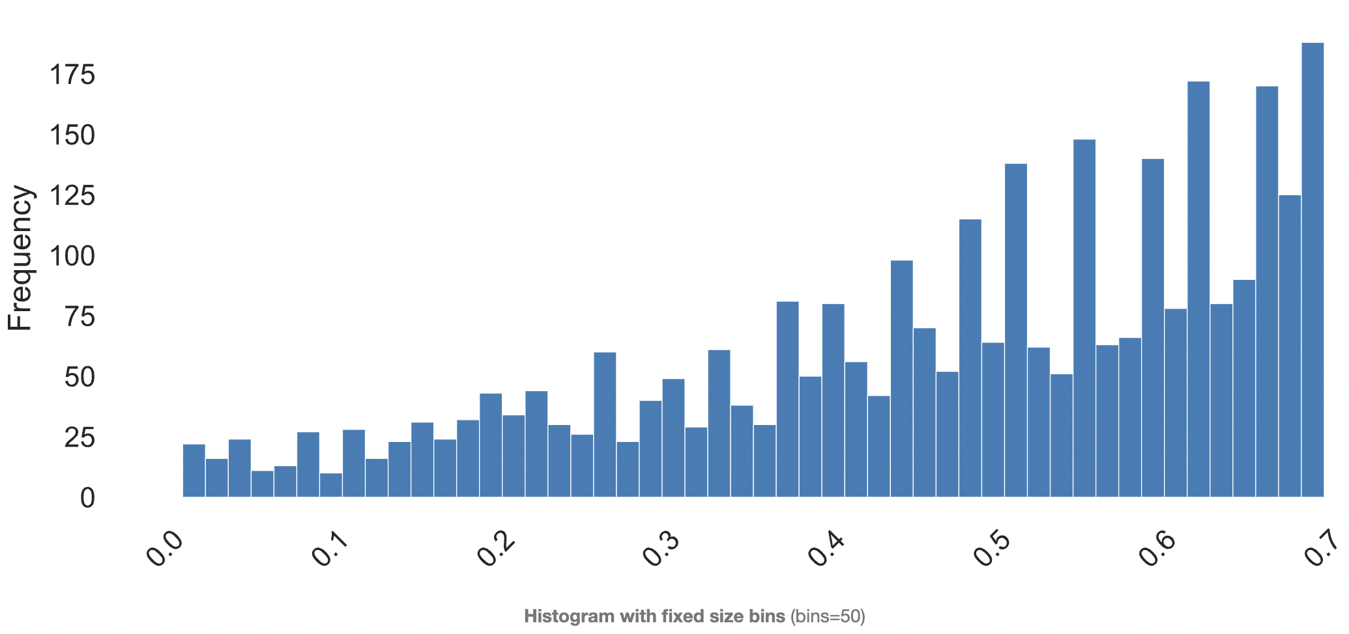
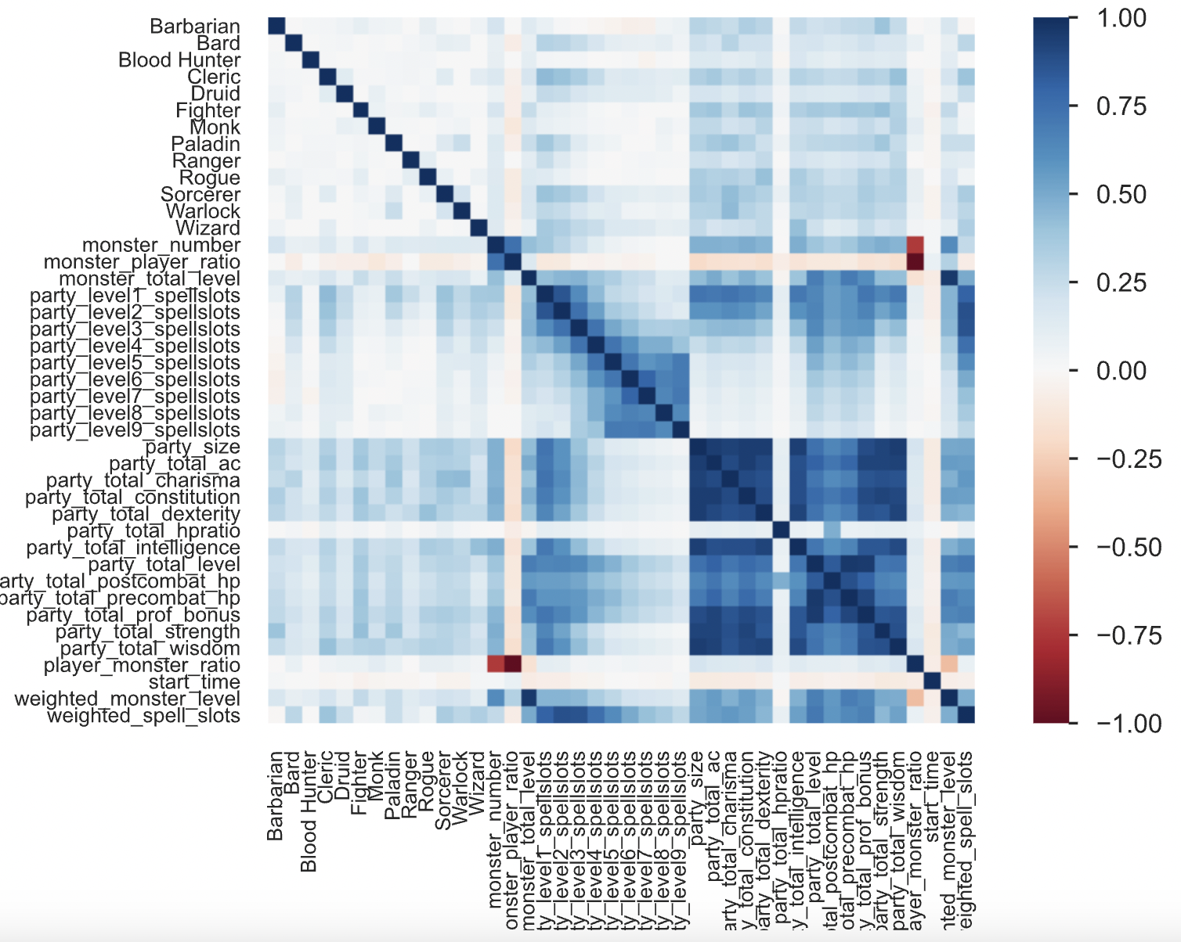
Scaled & Filtered (04-05) – No TPK & HP Ratio < 0.7
11507 Observations Initially → 3063 Observations
HP Ratio Histogram
Removed all instances of HP Ratio >= 0.71 and all TPKs
Negligible correlations

